Slide 1
Timebox 3 - Spotify Playlist Generator
BeatBuilders

Slide 2
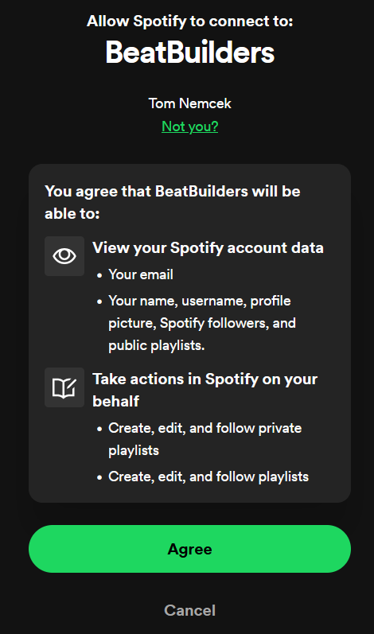
Spotify Authorization with NextAuth
- Successful sign in with Spotify account
- Getting user tokens that have higher privileges
- Next step is token management and playlist creation flow with songs from app

Slide 3
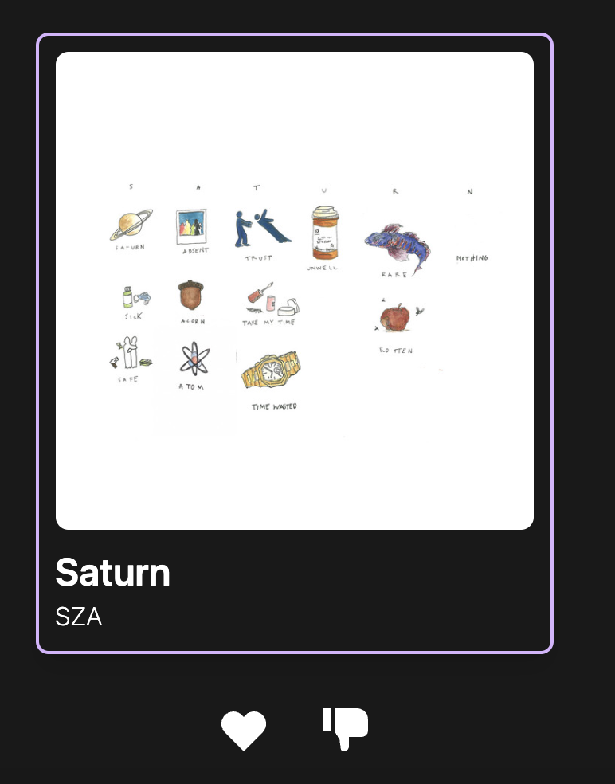
Added Album Art
- Used Spotify API to pull a 640x640 album art image of any song given its title and artist
- The API gives a link to an image and the <img> tag renders it on the page, so there is no need to download the images
- Song cards are automatically updated when the song title and artist changes

Slide 4

Added Song Playback Capability
- Song cards now have a 30 second song preview from the Spotify API
- Unlike album art, many songs do not have a preview on Spotify so we added the Deezer API as a backup
- MP3 audio link is given by either API and rendered through an <audio> tag

Slide 5
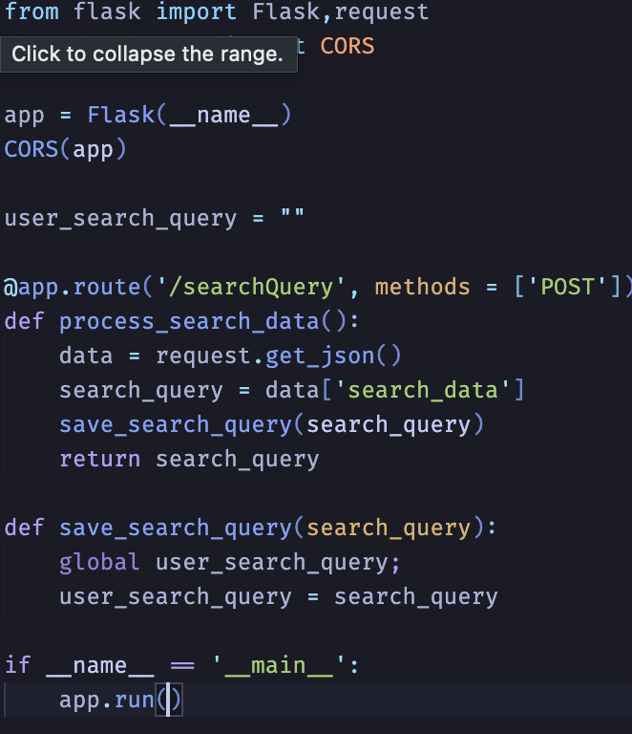
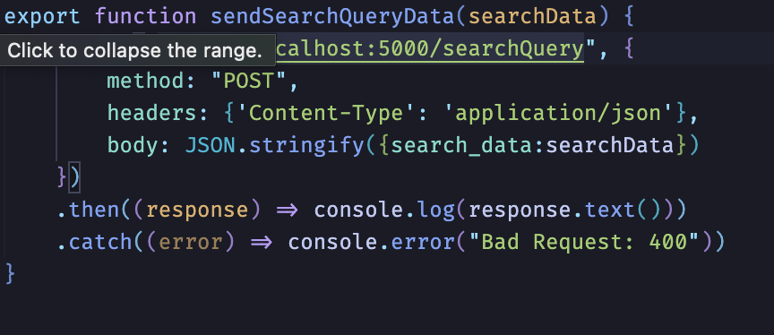
Flask API
Orchestrate information transfer from frontend forms to backend services (LLM & Elasticsearch)
Flask API Endpoint
Demo
JS API Call

Slide 6
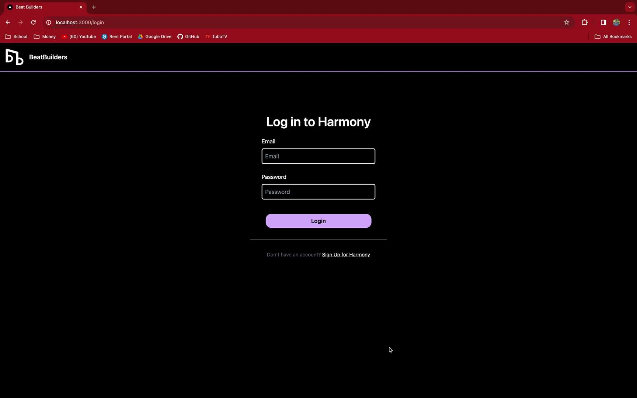

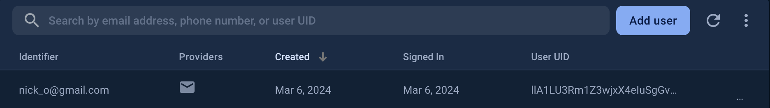
Routing for Successful Sign-up and Login
Routing after Sign-Up
Routing after Login

Slide 7
ElasticSearch
Goal:
Use multiple RANGE filters to query ElasticSearch using AND/MUST boolean structure
Ex: {“range”: {“accousticness”: {“gte”: 0.5}}}
Example Input from LLM
{“accousticness”: 0.5, “danceability”: 0.3, “loudness”: 0.7, “valence”: 0.2}
Current Status
Able to generate output using one attribute or several through SHOULD/FILTER structure
Using the “should” query ensures correctness of only one range filter
Trouble getting proper output with AND/MUST structure

Slide 8
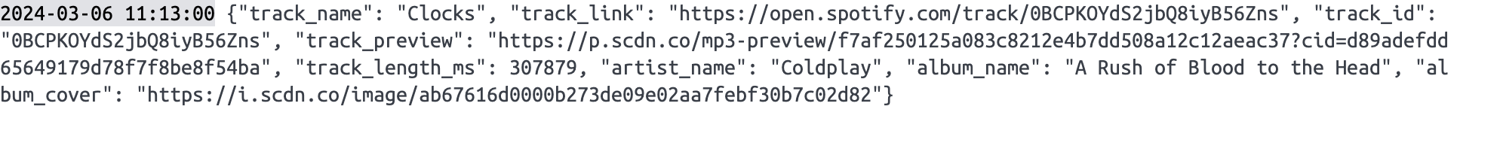
Contacting Spotify API
Getting Spotify-specific information from Spotify API based on Elasticsearch output
Filtered, and restructured in new JSON to eventually connect to front end
Easy to add/remove more data as we continue to develop
Next steps:
Determine solution to having multiple of same song returned by Spotify API (how do we handle remixes, remasters, acoustic versions, etc?)
Fully integrate with front end

Slide 9


Llama 2
Encapsulated into llama_generator class:
Changed some functionality to allow LLM to omit attributes if it is unsure about its value
….

Slide 10

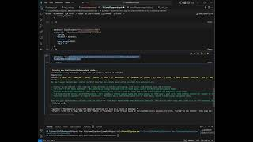
ElasticSearchDBChain
elasticsearch
Llama 2
Advantage: Simplifies backend, LLM knows about everything in the database
Goal: explore and see if it is viable
Results:
Notes:
Connecting Elasticsearch to the LLM would be very much simplified
Not perfect but it is elegant
We have proof that our LLM is referencing the songs in the spotify database
And giving recommendations

Slide 11
Next Steps
Achieving full integration between the Frontend, Elasticsearch, and the LLM
Modifying front end components so that they allow successful Spotify Auth
Building queries with multiple ranged features

